Slide 2
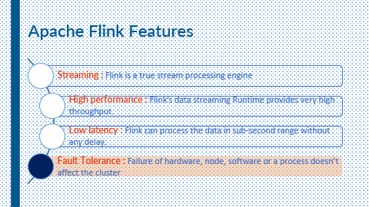



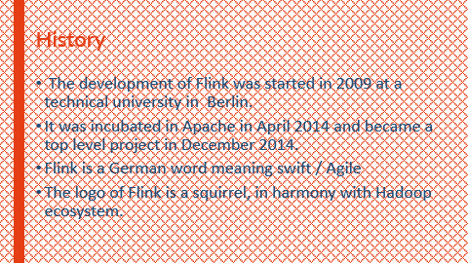
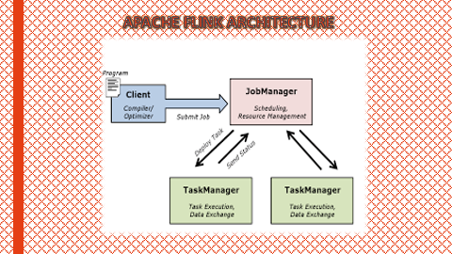
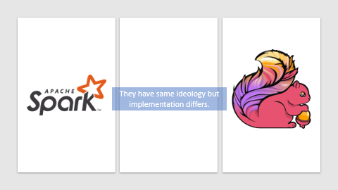
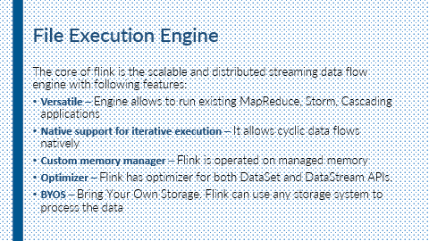

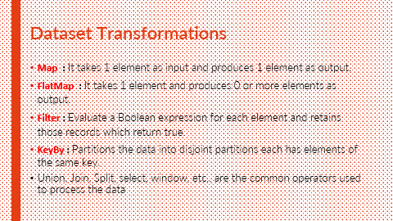
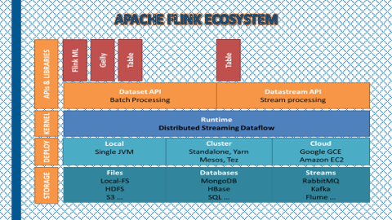
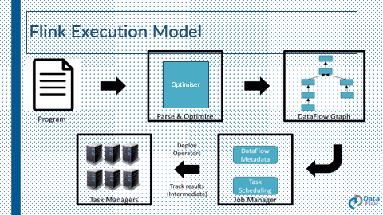
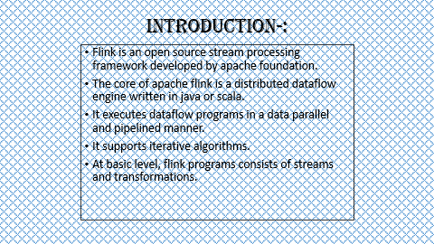


Slide 3




Apache Flink

Slide 4
Apache Flink

Slide 5
What we will learn today??
Introduction to Apache Flink
History of Apache Flink
Apache Flink Ecosystem
Apache Flink Architecture
Batch as a special case for streaming
Features
Dataset Transformations
Execution Model
Execution Engine
Difference between spark and flink.
Who uses flink?

Slide 6
INTRODUCTION-:
Flink is an open source stream processing framework developed by apache foundation.
The core of apache flink is a distributed dataflow engine written in java or scala.
It executes dataflow programs in a data parallel and pipelined manner.
It supports iterative algorithms.
At basic level, flink programs consists of streams and transformations.

Slide 7
History
The development of Flink was started in 2009 at a technical university in Berlin.
It was incubated in Apache in April 2014 and became a top level project in December 2014.
Flink is a German word meaning swift / Agile
The logo of Flink is a squirrel, in harmony with Hadoop ecosystem.

Slide 8
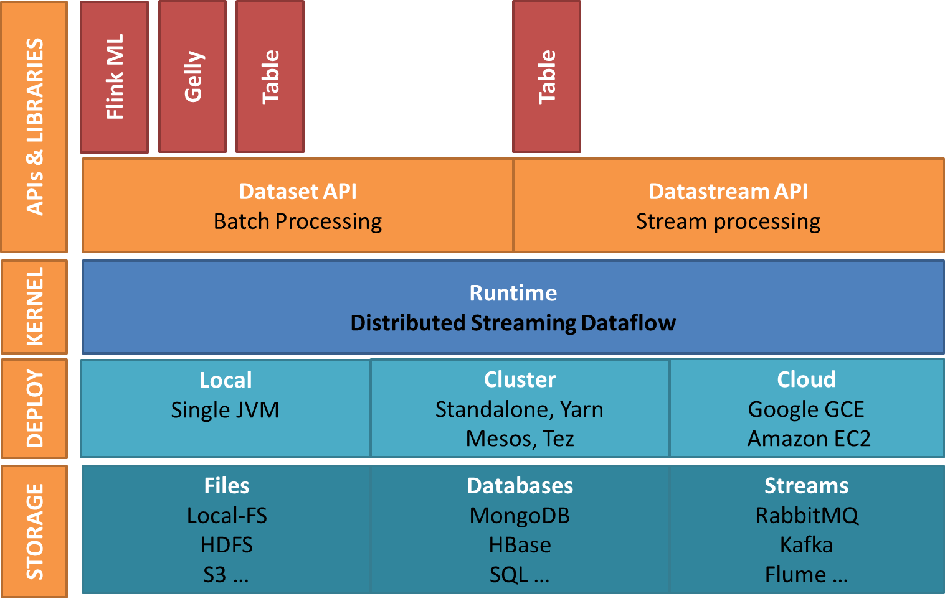
APACHE FLINK ECOSYSTEM

Slide 9
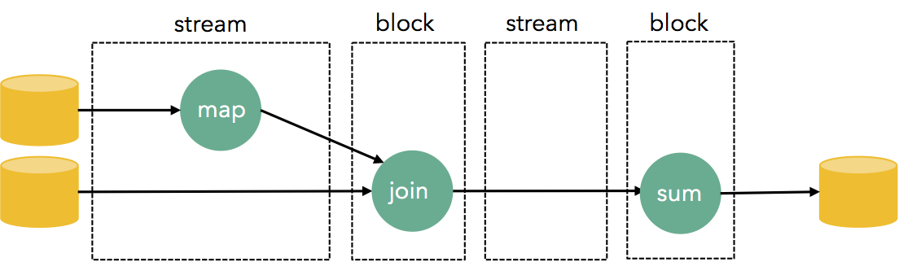
BATCH AS A SPECIAL CASE OF STREAMING
When a batch processor reads a file, it streams the file to the first operator. If the first few operators are record-by-record transformations such as filters, mappers, etc, then the data is still streamed through the operator code (often by “chaining” operators together). However, at the first blocking operator (e.g., sort, aggregation, etc) a batch processor blocks the output until all the input of the operator has been produced. Flink follows the philosophy of streaming end-to-end, by embedding blocking operators within streaming tasks.

Slide 10
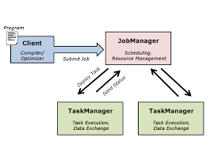
APACHE FLINK ARCHITECTURE

Slide 11
Apache Flink Architecture
Client
1.type extraction
Job Manager
1.parallelization: create execution graph.
Task Manager
Operations are split up into task depending on specified parallelism.
2. optimise in all APIs
3.construct job dataflow
4.Pass job dataflow to job manager.
5.retrieve job result.
2. scheduling: assigns the task to task manager.
3. state tracking: supervise the execution

Slide 12
Apache Flink Architecture
Flink works in Master-slave fashion.
There are two nodes :
Master Node
Slave Node.
Master is the manager node of the cluster where slaves are the worker nodes.
As shown in the figure master is the centerpiece of the cluster where the client can submit the work/job /application.
Now master will divide the work and submit it to the slaves in the cluster.
In this manner, Flink enjoys distributed computing power which allows Flink to process the data at lightning fast speed.

Slide 13
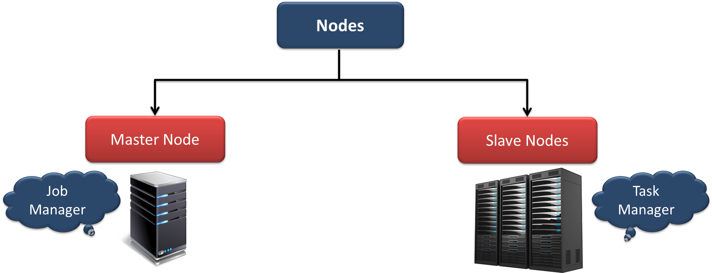
Apache Flink Architecture
On Master node, the Master Daemon of Flink called “Job Manager” runs.
On all the Slave nodes the Slave Daemon of the Flink called “Task Manager” runs.

Slide 15
Apache Flink Features
Streaming : Flink is a true stream processing engine
High performance : Flink’s data streaming Runtime provides very high throughput.
Low latency : Flink can process the data in sub-second range without any delay.
Fault Tolerance : Failure of hardware, node, software or a process doesn’t affect the cluster

Slide 16
Apache Flink Features
Memory management : Flink works in managed memory and never get out of memory exception
Broad integration : Flink can be integrated with the various storage system to process their data
Program optimizer : Flink is shipped with an optimizer, before execution of a program it is optimized
Scalable : Flink is highly scalable. With increasing requirements, we can scale flink cluster.

Slide 17
Apache Flink Features
Little tuning required : Requires no memory, network, serializer to configure
Exactly-once Semantics : It can maintain custom state during computation
Rich set of operators : Flink has lots of pre-defined operators to process the data.

Slide 18
Dataset Transformations
Map : It takes 1 element as input and produces 1 element as output.
FlatMap : It takes 1 element and produces 0 or more elements as output.
Filter : Evaluate a Boolean expression for each element and retains those records which return true.
Union, Join, Split, select, window, etc.. are the common operators used to process the data

Slide 19
Flink Execution Model
As shown in the figure following are the steps to execute the applications in Flink:
Program – Application program was written by the developer.
Parse and Optimize – The code parsing, Type Extractor, and Optimization are done during this step.
Job Manager – Now job manager schedules the task on the task managers; keeps the data flow metadata. Job manager deploys the operators and monitors the intermediate task results
Task Manager – The tasks are executed on task manager, they are the worker nodes.

Slide 20
File Execution Engine
The core of flink is the scalable and distributed streaming data flow engine with following features:
Versatile – Engine allows to run existing MapReduce, Storm, Cascading applications
Native support for iterative execution – It allows cyclic data flows natively
Custom memory manager – Flink is operated on managed memory
Optimizer – Flink has optimizer for both DataSet and DataStream APIs.
BYOS – Bring Your Own Storage. Flink can use any storage system to process the data

Slide 21


They have same ideology but implementation differs.

Slide 22

They have same ideology but implementation differs.

Slide 23

Languages
Scala, Python
R, Java
Languages
Scala, Java
Abstraction
DataFrame
DStream
Abstraction
DataSet
DataStream
Streaming
Near-Realtime
Streaming
Realtime
High Latency
Low-Latency
No Optimization
Optimization
Still in Development
Mature
And
Complete
Still in Development

Slide 24
In-Memory Processong
In-Memory Processong
No Record of
previous data
Record of
previous data
Streaming
Near-Realtime
Streaming
Realtime
Streaming as
fast batch
processing
Batch as
special case
of Stream
Processing
Fraud
Detection
Fraud Prevention
CAN
Maintain high
throughput
High
throughput

Slide 25
Who uses Flink?

Slide 26





Who uses Flink?
King, the creators of Candy Crush Saga, uses Flink to provide data science teams a real-time analytics dashboard.
Mux, an analytics company for streaming video providers, uses Flink for real-time anomaly detection and alerting.
Alibaba, the world's largest retailer, uses a fork of Flink called Blink to optimize search rankings in real time.

Slide 27
Now we know Flink. But what’s Blink?
A forked version of Flink used by Alibaba Group
Best for Alibaba’s large cluster

Slide 28


Slide 29
Enough Theory… It’s time for Live Action!

